Slide 1

Laundry Now
Senior Design Project Submitted By:
Frank Monforte, Ryan Russell
Sonoma State University Department of Engineering Science
Advisor: Dr. Farid Farahmand
Client: Tramaine Austin-Dillon
SSU Residential Area Coordinator – Sauvignon Village East
laundrynowssu.weebly.com
laundrynowssu@gmail.com

Slide 2
Overview
Problem Statement
Product Comparison
10 Deliverables
System Block Diagram
Final Product Images
Schematics
Product Testing
Challenges/Changes
Future Work
Presentations
Supporting Classes
Acknowledgements

Slide 3
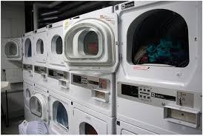
The Problem
•6 Million People in California Living in Apartments.
•No Way to Determine if Washers or Dryers are Available for Use Without Making a Trip to the Laundry Room
•Difficult for Management to Keep Track of Which Machines are Being Used the Most (Maintenance and Repairs) and Which Machines May be Broken Down

Slide 4
Project Goal
Design an easy to install, inexpensive monitoring system that allows users to check the status of machines in the laundry room. Include usage count so management can see which machines are being used the most (maintinence and repairs).
Expandable based on number of machines
Non-Invasive Design
Inexpensive to Purchase and Install
Simple to use and reliable
Track machine usage data

Slide 5
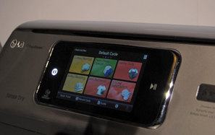
Similar Products
LaundryView by Mac-Grey Corp.
Designed To Work With Their Supplied Washers/Dryers
Allows Users To See What Machines Are Running/Time Left
Costly, Requires Wi-Fi Enabled Washers/Dryers
Remote Laundry Monitoring System by LG
Invasive (Modems Need To Be Installed On Machines)
Only In Home
Requires An Extra Plug In Unit
Approximately $90

Slide 6
10 Deliverables
Snap together sensor design allowing for easy configuration and node replacement.
Able to determine if a washing machine or dryer is in operation or stopped.
SD card saves and backs up usage data when there is a lack of power.
Website displays status of every machine and updates every 5 minutes
Ability to access the website from anywhere with internet access (router port forwarding) and on LAN (Wi-Fi).
Automatically detects the number of sensors nodes on machines.
Viewable on the website, the number of cycles per machine for day, week, month.
Indicates on the website if a machine may need maintenance dues to lack of use.
Noninvasive designed sensors can be attached without modifying pre-existing equipment.
Continuously tracks sensor data even if the server is not connected to the Wi-Fi.

Slide 7
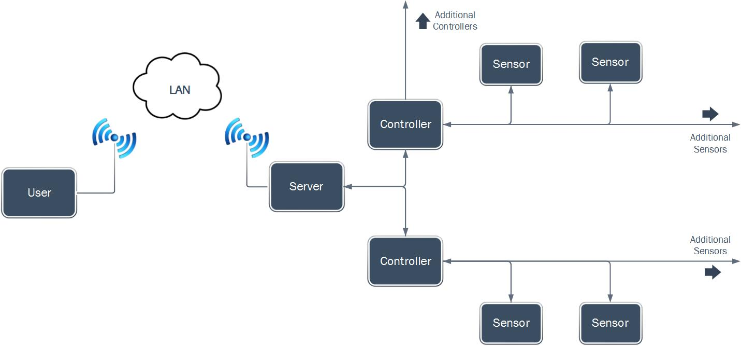
Design

Slide 8
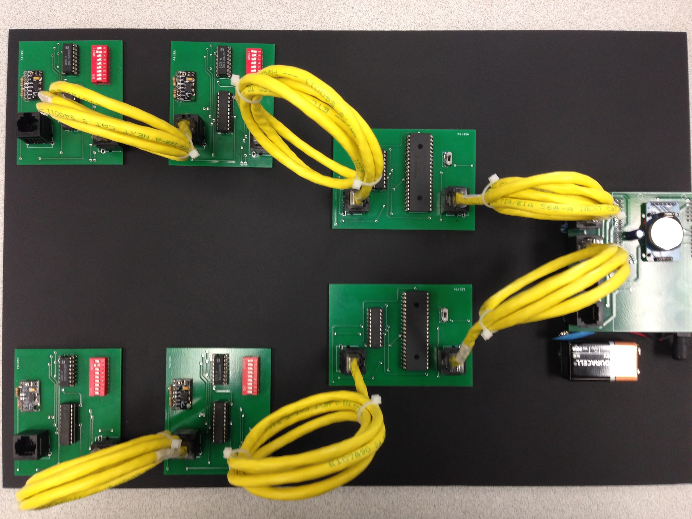
Project

Slide 9
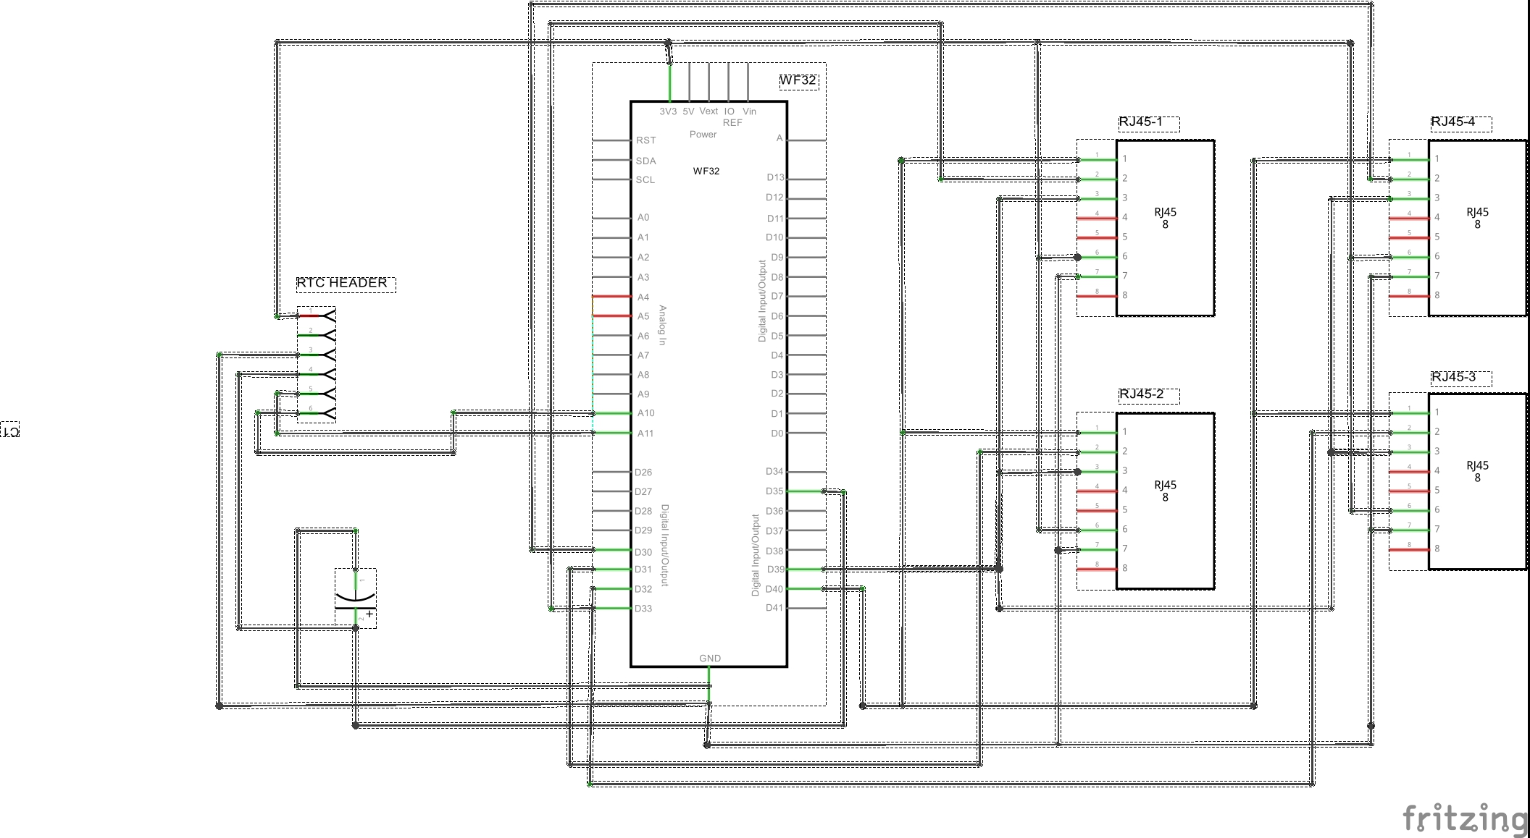
Server Schematic

Slide 10
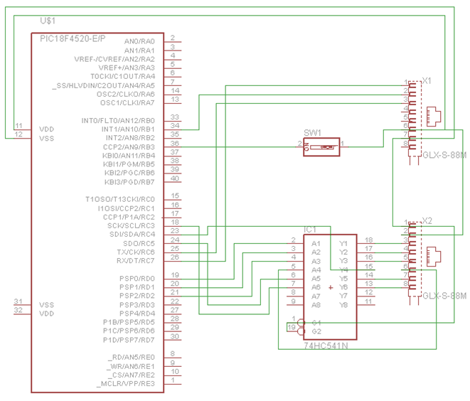
Controller Node Schematic

Slide 11
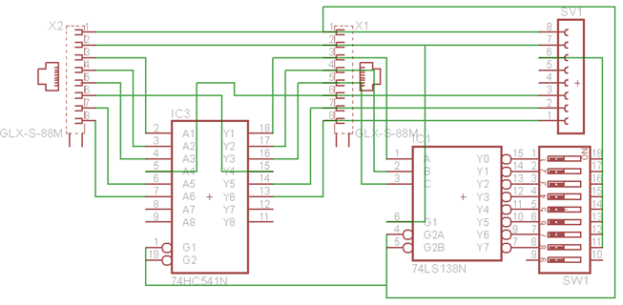
Sensor Node Schematic

Slide 12
Testing
Bench Testing
Sensor communication testing
Serial communication over distance (Controller Node / Sensor Node)
Parallel communication over distance (Server / Controller Node)
Wi-Fi distance
On Site Testing
Best sensor mounting location
Machine configuration
Best time delay for sensor reading
Averaging data points for sensor reading (dryer and washing machines)

Slide 13
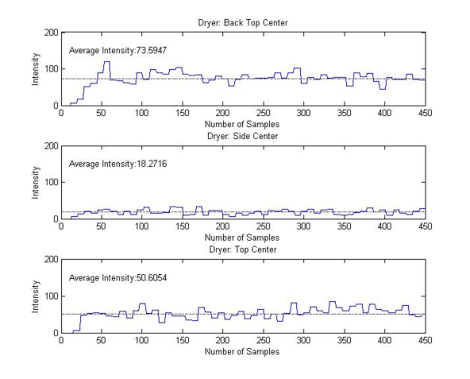
Sensor Mounting Location
In order for Laundry Now to get the best sensor reading it was required to find the most optimal mounting location for the sensor nodes.

Slide 14
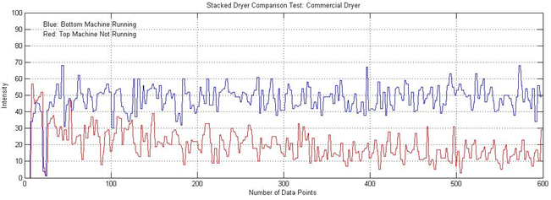
Machine Configuration

Slide 15
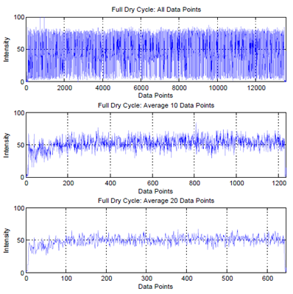
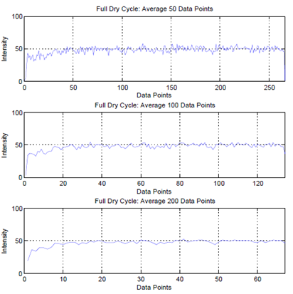
Dryer Average

Slide 16
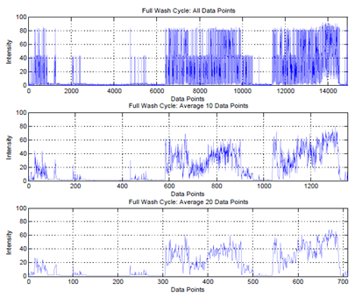
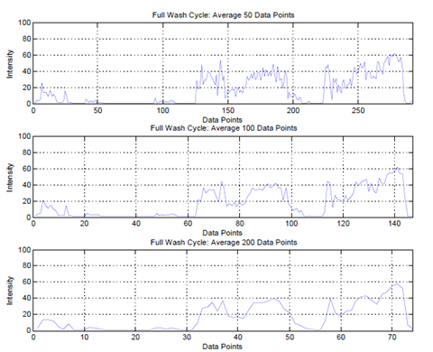
Washing Machine Average

Slide 17

Possible Problems
Challenges/Changes
False Triggers
Machines Too Quiet
Wi-Fi Router not in Range
Users not in Range of Wi-Fi
Unable to Access back of Machine
Loose Connection Due to Continuous Wear
Loss of SPI data Communication on PCB’s
SD Card
WPS (Wi-Fi Protected Setup)
“Just Finished” Status on Webpage

Slide 18
Future Work
Incorporate door detection into controller algorithm
Ability to detect movement on stacked machines by comparison between sensor nodes
Add a work order request page for users on the webpage (reporting errors)
Incorporate graph that displays machine usage data for day, week, year on the webpage
Sever able to support more network security types (other than just WPA2)
Server supports configurable IP address in the network settings file
Implement a pressure sensor which will allow for the determination of the load being removed

Slide 19
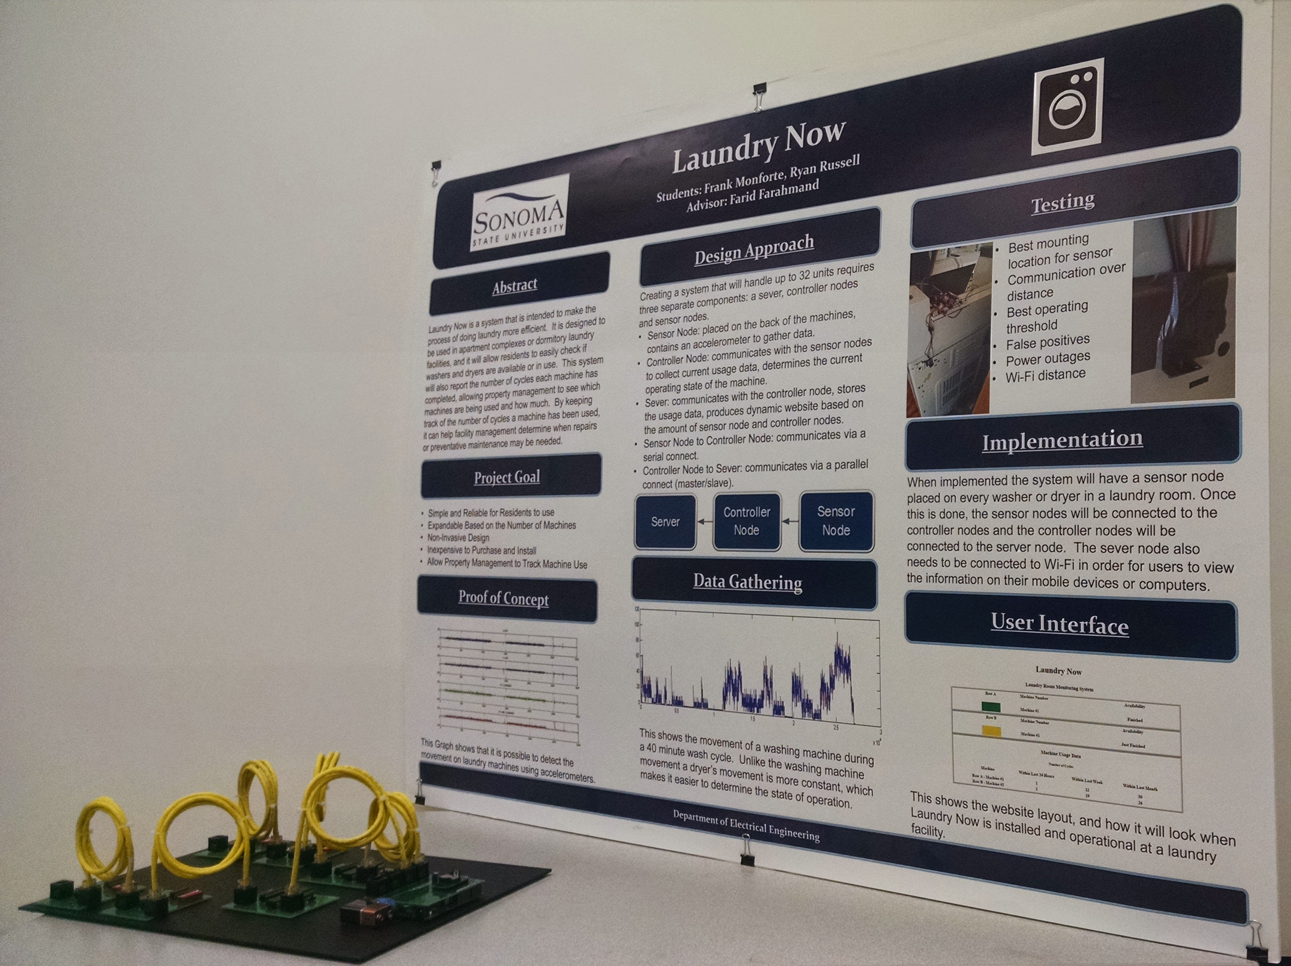
Presentations
SSU Research Symposium
April 15, 2015
Market Day
April 21, 2015
SSU Science Symposium
May 7, 2015
Funded through the WATERS Collaborative

Slide 20

Supporting Classes
Programming (CS115)
Fundamentals of Logic Design (ES112)
Digital Logic Design (ES210)
Advanced Programming (ES314)
Microprocessor and System Design (ES310)
Wireless Communication (ES485)
Intro to Networking (ES465)

Slide 21
Acknowledgements
Farid Farahmand
Tramaine Austin-Dillon
Haider Khaleel
Ali Kujoory
Shahram Marivani

Slide 22
References
1) http://www.macgray.com/
2) http://www.campus-solutions.net/index.html
3) http://www.amazon.com/LG-Electronics-RLM20K-Laundry-Monitoring/dp/B0012OMY2K
4) http://www.maytag.com/Laundry-1/Laundry_Laundry_Appliances_Washers-3/102120050+4294966015/
5) http://www.nmhc.org/Content.aspx?id=4708
6) http://www.analog.com/static/imported-files/data_sheets/ADXL345.pdf
7) https://www.sparkfun.com/products/9836
8) http://ww1.microchip.com/downloads/en/DeviceDoc/41303G.pdf
9) http://ww1.microchip.com/downloads/en/DeviceDoc/61156H.pdf
10) http://ww1.microchip.com/downloads/en/DeviceDoc/70686B.pdf
11) https://www.digilentinc.com/Products/Detail.cfm?NavPath=2,892,1193&Prod=CHIPKIT-WF32

Slide 23
Questions/Comments
Laundry Now
Senior Design Project Submitted By:
Frank Monforte, Ryan Russell
Sonoma State University Department of Engineering Science
Advisor: Dr. Farid Farahmand
laundrynowssu.weebly.com

Slide 24
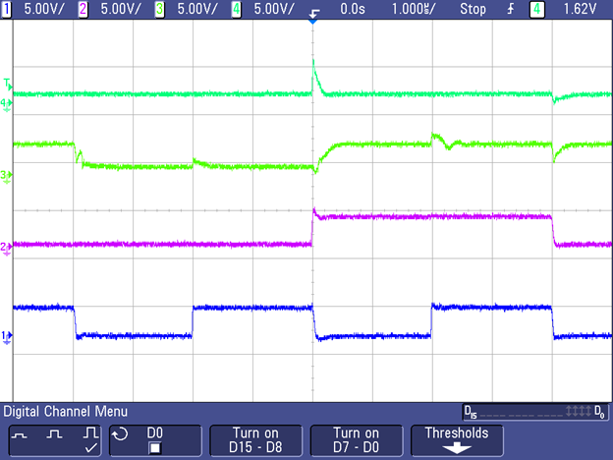
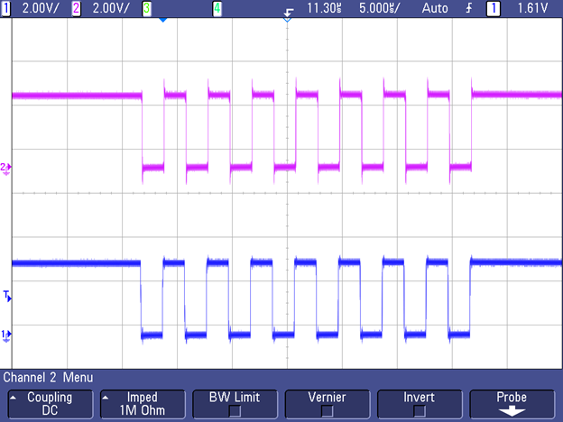
SPI Communication Over Distance

Slide 25
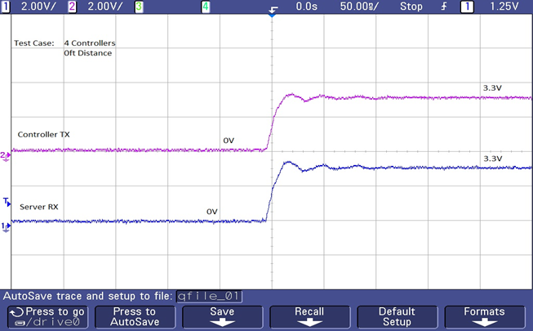
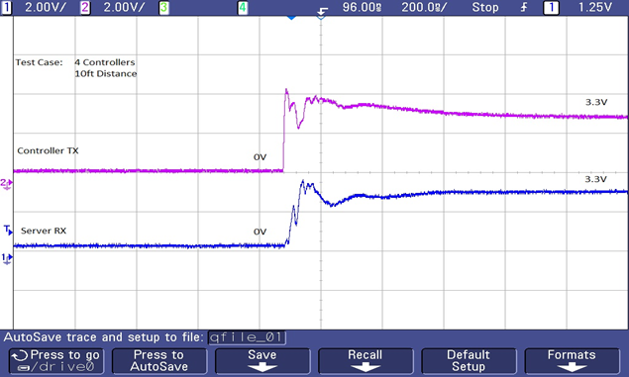
UART Communication Over Distance

Slide 26
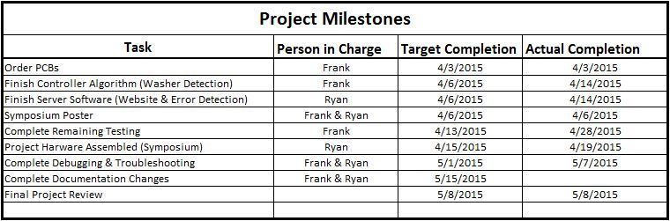

Slide 27
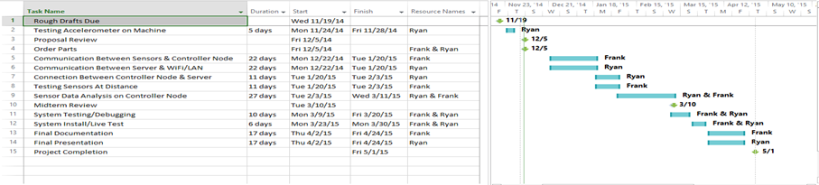

Slide 28
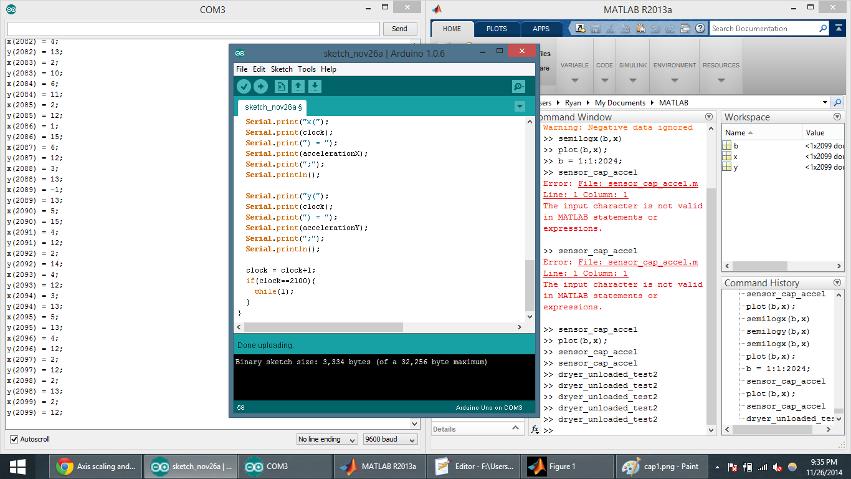
Sensor Test Results
Parallax 2-Axis MEMS Accelerometer
Digital Output to Arduino Uno
Data sent serially to laptop
Data Points plotted in MATLAB
Results analyzed

Slide 29
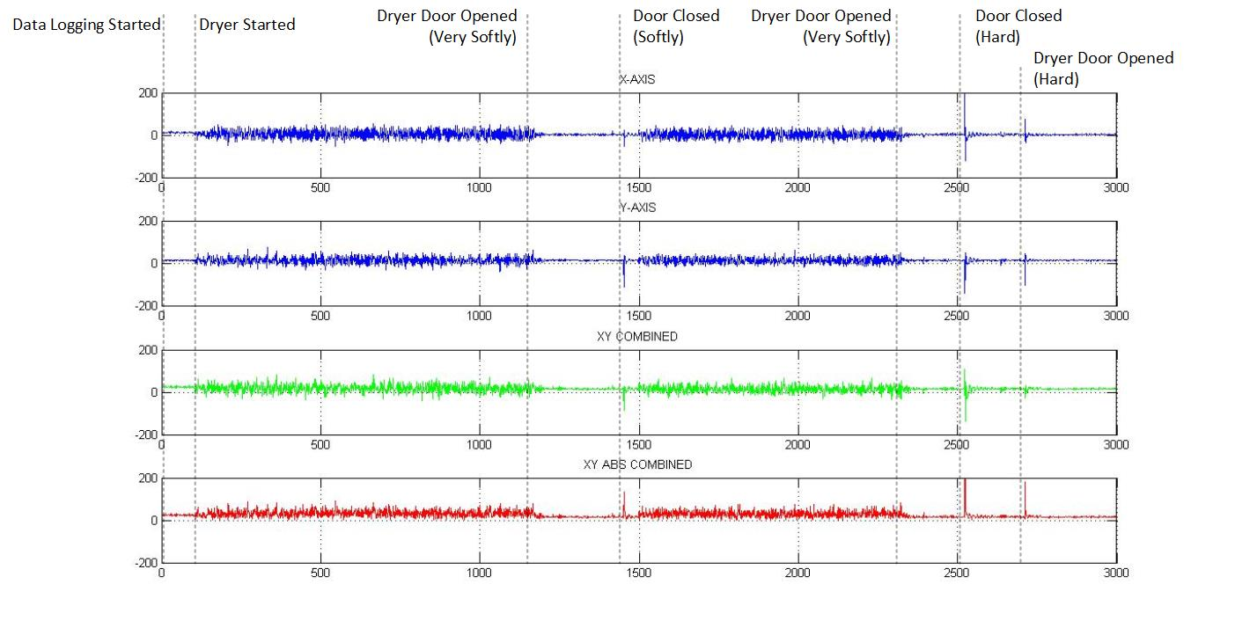

Slide 30
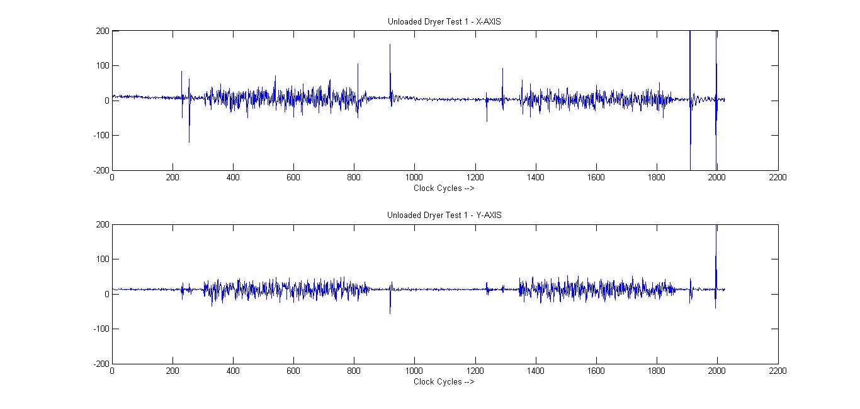

Slide 31
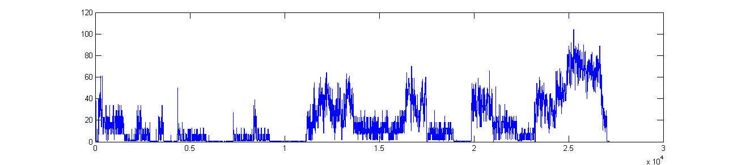
Testing

Slide 32
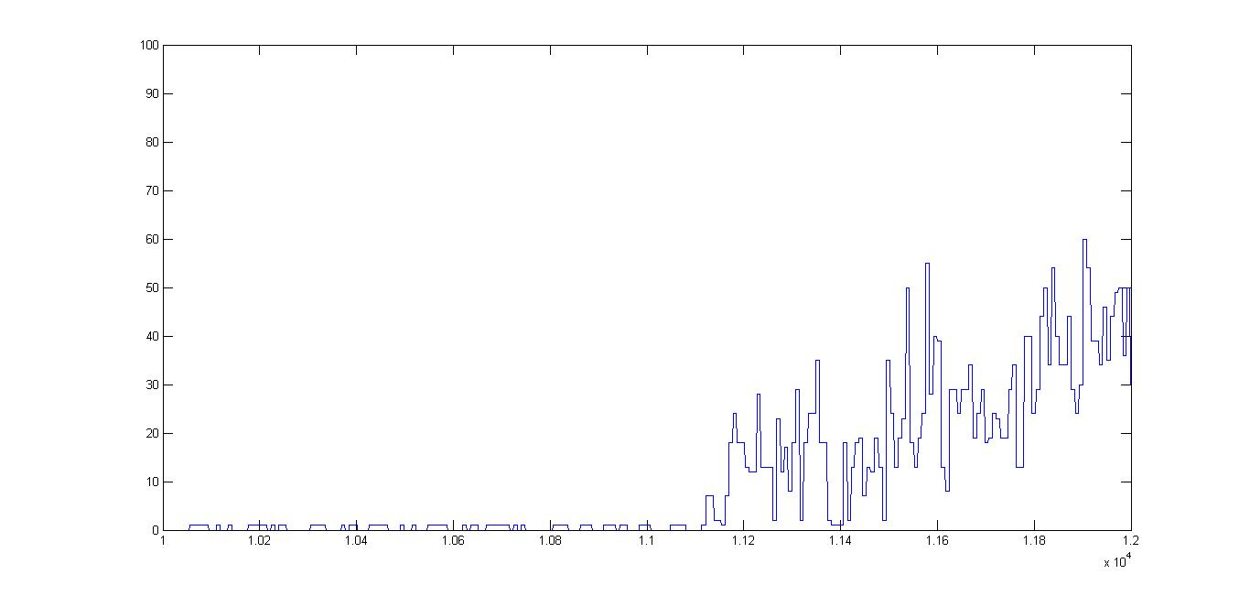
Testing

